Slide 1
WORLD OF DRONE
Drone Application: Law Enforcement

Slide 2
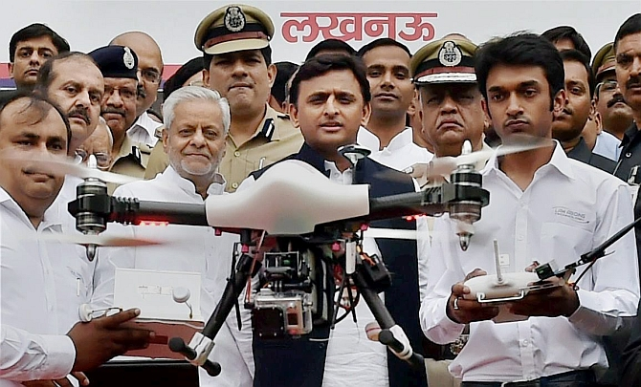
Drone Application: Law Enforcement
Many police departments in India have procured drones for law and order and aerial surveillance

Slide 3
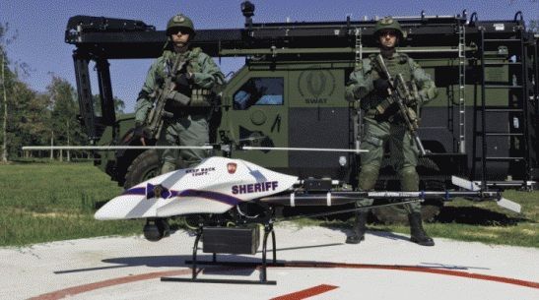
Drone Application: Law Enforcement
UAVs have been used for domestic police work in Canada and the United States.

Slide 4
Drone Application: Law Enforcement
The Italian company Selex ES has provided an unmanned surveillance drone to the Democratic Republic of Congo to monitor movements of armed groups in the region and to protect the civilian population more effectively.

